Slide 1
Chapter 4: Network Layer
Freshman Seminar
2022.02.25
Sumin Sohn

Slide 2
Contents
4.1 Introduction
4.2 Virtual Circuit and Datagram Networks
4.3 Inside a Router
4.4 The Internet Protocol
4.5 Routing Algorithms
4.6 Routing in the Internet
4.7 Broadcast and Multicast Routing

Slide 3
4.1 Introduction

Slide 4
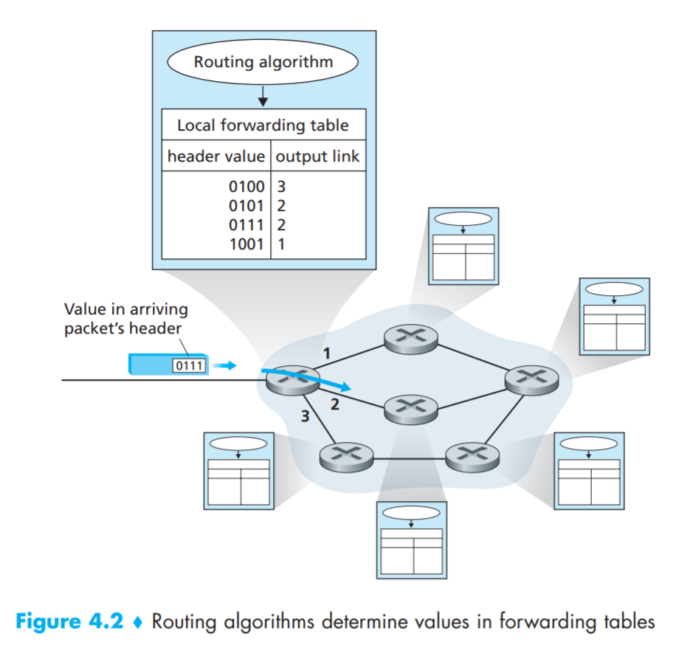
Forwarding and Routing
Forwarding
Router transfer a packet from an input link interface to the appropriate output link interface
Routing
Determining end-to-end paths from source to destination
Forwarding Table
Router forwards a packet by examining the value of header
Link-layer Switch
Some router forward the packet based on values in the link-layer frame

Slide 5
Connection Setup
TCP did a three-way handshake
Allowing sender and receiver to set up the needed information
Routers along the chosen path
Setting up the state before connection can begin flow

Slide 6
Network Services
Guaranteed delivery (with bounded delay)
Guarantee the packet will arrive(within time limit)
In-order packet delivery
Guarantee the packet arrives in the order
Guaranteed minimal bandwidth
Emulates the transmission link of specified bit rate
Guaranteed maximum jitter
Amount of time between two packets for sender and recipient is same
Security services
Network layer can also encrypt/decrypt the datagram

Slide 7
Network Service Models
Network Architecture | Service Model | Bandwidth Guarantee | No-Loss Guarantee | Ordering | Timing | Congestion Indication
Internet | Best effort | None | None | Any order possible | Not maintained | None
ATM | CBR | Guaranteed constant rate | Yes | In order | Maintained | No congestion
ATM | ABR | Guaranteed minimum | None | In order | Not maintained | Congestion indication

Slide 8
Constant Bit Rate
First ATM service model to be standardized
책내용 쓰는 것은 별로 의미 없어보이고 추가적으로 조사해서 넣어야 할거 같음

Slide 9
Available Bit Rate

Slide 10
4.2 Virtual Circuit and Datagram Networks

Slide 11
The Difference between Virtual Circuit and Datagram Networks
Transport layer provides services to process
Network layer provides service to host
Virtual circuit network
Connection-oriented service on network layer
Datagram network
Connectionless service on network layer

Slide 12
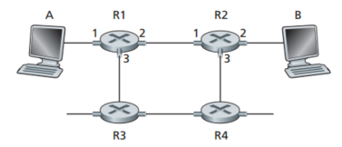
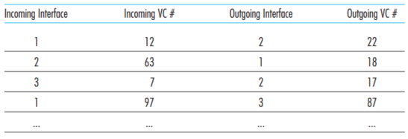
Virtual-Circuit Networks
Virtual-Circuit consists of
A path between the source and destination
VC numbers for each link along the path
Entries in the forwarding table in each router along the path
When a new VC is established across a router
Entry is added to the forwarding table
The network’s routers must maintain connection state information

Slide 13
Example of Virtual Network
A packet belonging to a virtual circuit carry a VC number in its header
Router has its table to connect input interface to input VC number and output interface to output VC number
VC is dependent on router
Router changes VC number in the packet according to forwarding table
Similar to setting circuit between two telephony hosts

Slide 14
Identifiable Phases in a Virtual Circuit
VC setup
The network layer determines the path and VC number between sender and receiver
Network layer adds an entry in the forwarding table in each router along the path
Data transfer
Packets begin to flow along the VC
VC teardown
Terminate the VC
A VC network layer is fully aware of each router along the path

Slide 15
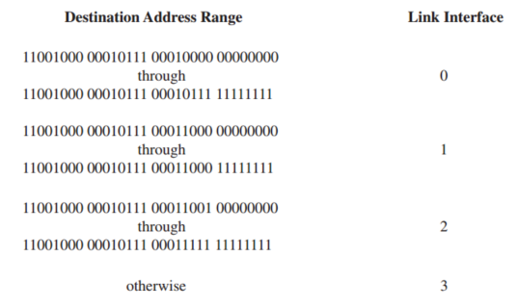
Datagram Networks
Datagram network stamps the packet with the address of destination end system
Only Address is used to determine corresponding link interface
Routing algorithms update forwarding table

Slide 16
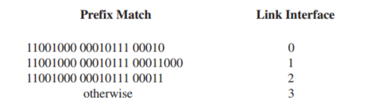
Longest Prefix Matching Rule
It is possible for a destination address to match more than one entry
It finds the longest matching entry in the table
E.g., If certain address match the second entry and third entry it matches to the longer entry

Slide 17
4.3 Inside a Router

Slide 18
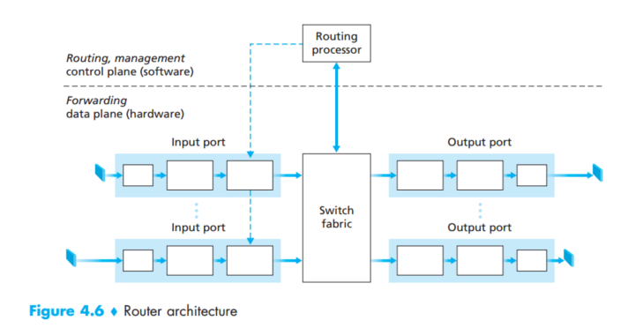
Router Components
Input ports
Performs the physical layer function
Performs the link layer function
Performs the look up function
Switching fabric
Interconnects between input ports and output ports
Output ports
Routing processor
Executes routing protocols
Maintains connection state information

Slide 19
Router Plane
Forwarding plane is implemented on the hardware
Forwarding hardware can be implemented using a router vendor’s own hardware designs
The reason for hardware
Datagram-processing pipeline is far too fast for software implementation
Router control plane functions are implemented in software
Control functions
Routing protocols
Management functions

Slide 20
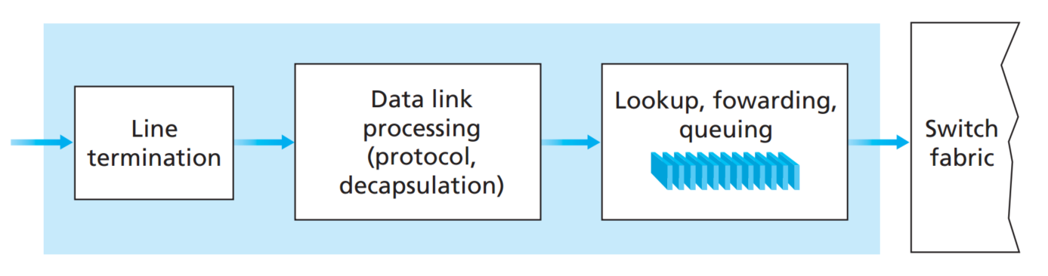
Input Processing
Line termination function
Implementing physical layer
Data link processing
Implementing link layer
Lookup
Router uses the forwarding table to find appropriate output port
The reason why hardware implementation is needed
Match plus action abstraction is not only used on router
Prevalent in network devices

Slide 21
Match Plus Action
쓰려 해도 별 내용 없어 보임
찾고 액션한다는 것으로 기억

Slide 22
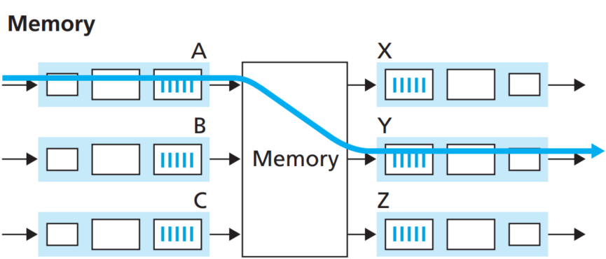
Switching via Memory
Switching between input and output ports is done under the control of routing processor
Input port with an arriving packet signaled interrupt
The packet is copied into memory
Processor look up appropriate output port
Processor copies the packet to the output port’s buffers

Slide 23
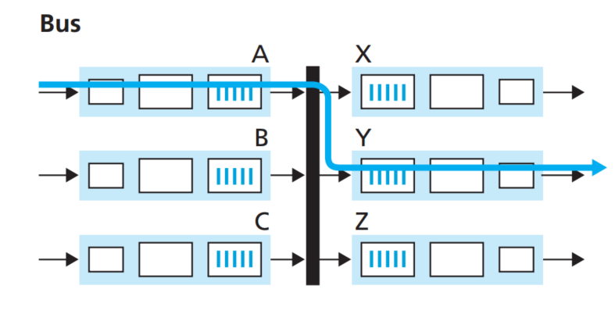
Switching via Bus
Input port directly transfers to output ports via bus without intervention of routing processor
Switch label is used to match
Removed at the output port
Similar to rotary
Operate in small local area
Only one packet can move on one time
Switching speed is limited by bus speed

Slide 24
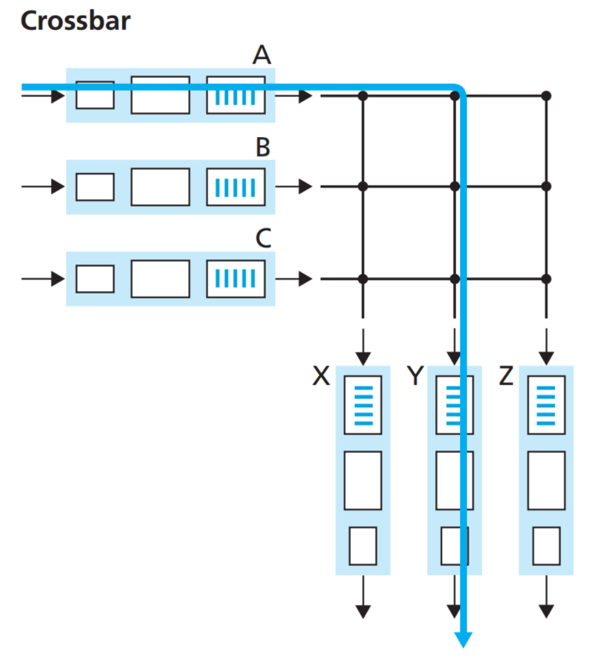
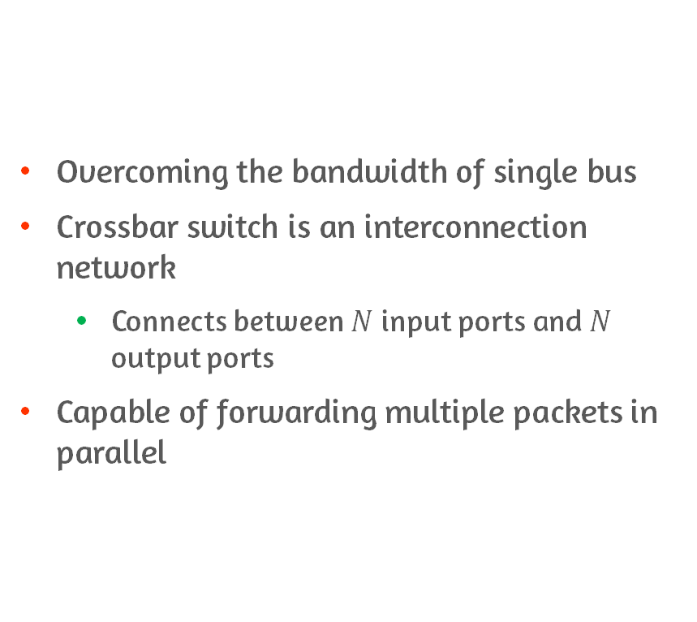
Switching via an Interconnection Network
Overcoming the bandwidth of single bus
Crossbar switch is an interconnection network
Connects between $N$ input ports and $N$ output ports
Capable of forwarding multiple packets in parallel

Slide 25
Output Processing
Take packets that have been stored in the output port’s memory
Transmit packets over the output link
Must select and de-queue packets
Perform link-layer and physical layer functions

Slide 26
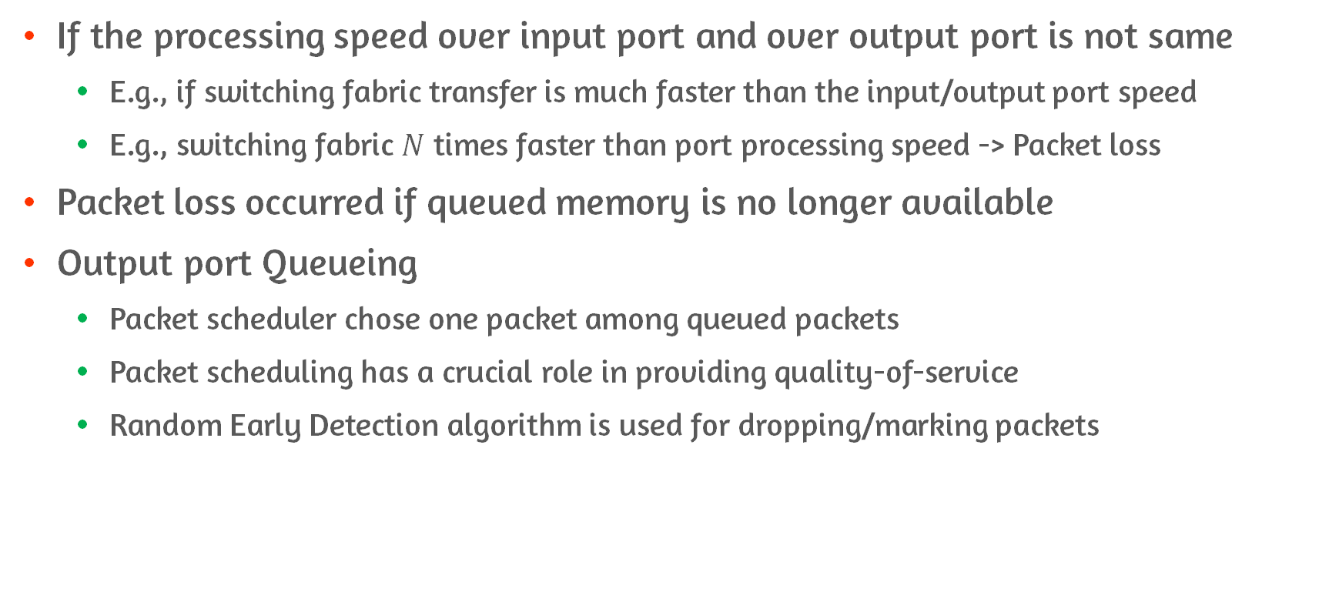
The Reason of Queueing
If the processing speed over input port and over output port is not same
E.g., if switching fabric transfer is much faster than the input/output port speed
E.g., switching fabric $N$ times faster than port processing speed -> Packet loss
Packet loss occurred if queued memory is no longer available
Output port Queueing
Packet scheduler chose one packet among queued packets
Packet scheduling has a crucial role in providing quality-of-service
Random Early Detection algorithm is used for dropping/marking packets

Slide 27
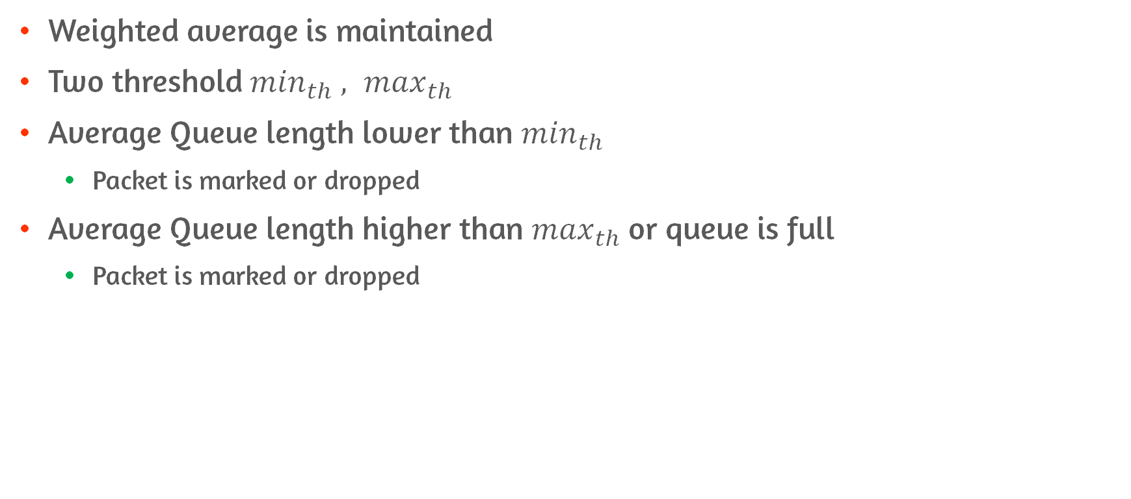
Random Early Detection Algorithm
Weighted average is maintained
Two threshold $\min_{th} , \max_{th}$
Average Queue length lower than $\min_{th}$
Packet is marked or dropped
Average Queue length higher than $\max_{th}$or queue is full
Packet is marked or dropped

Slide 28
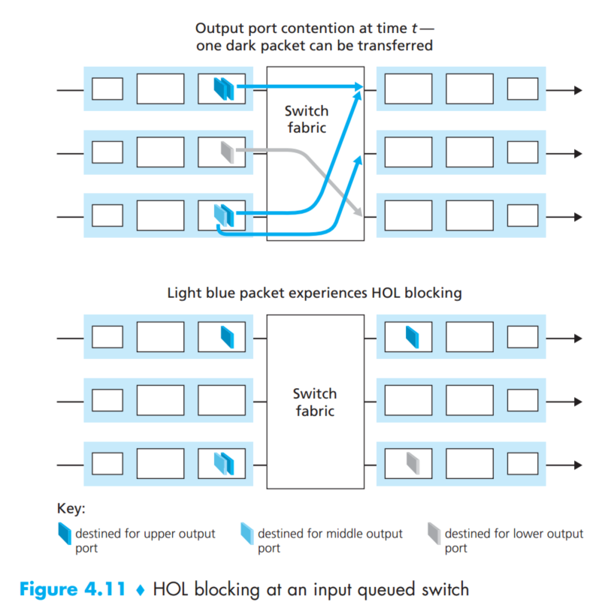
Head of Line Blocking
Consider switching speed is slow
Switching fabric can transfer only one packet to a given output port at a time
The second packet in the third input port memory need to wait
Waiting for the first packet to be processed
Not ideal situation since second packet’s destination is different

Slide 29
4.4 The Internet Protocol

Slide 30
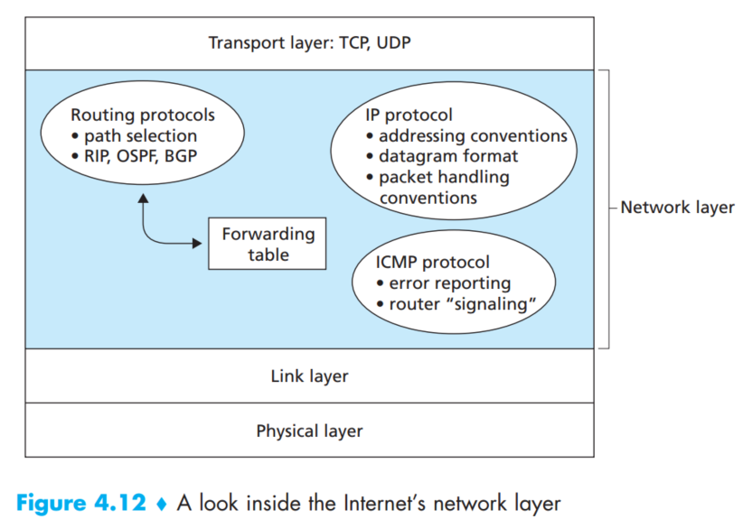
Components of Network Layer
IP protocol
The topic of this section
Routing component
Determine the path from the source and destination
Facility to report errors and respond to requests for certain network layer information
ICMP

Slide 31
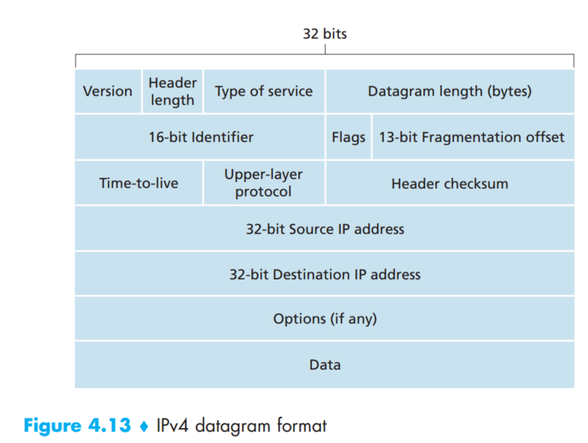
IPv4 Datagram Format #1
Version number
4bits specifying IP protocol version
Header length
Determine where the data locates
Type of service
Allow different types of datagrams
Distinguish real-time from non-real-time
Datagram length
Total length of datagram
Identifier, Flags, Fragmentation offset
Used for IP fragmentation – v6 don’t use it

Slide 32
IPv4 Datagram Format #2
Time to live
Ensure datagrams do not circulate forever
Protocol
Used only on a destination
Binds network layer and transport layer
Header checksum
Detecting bit errors
IP address
Options
IP header to be extended deleted on V6
Data

Slide 33
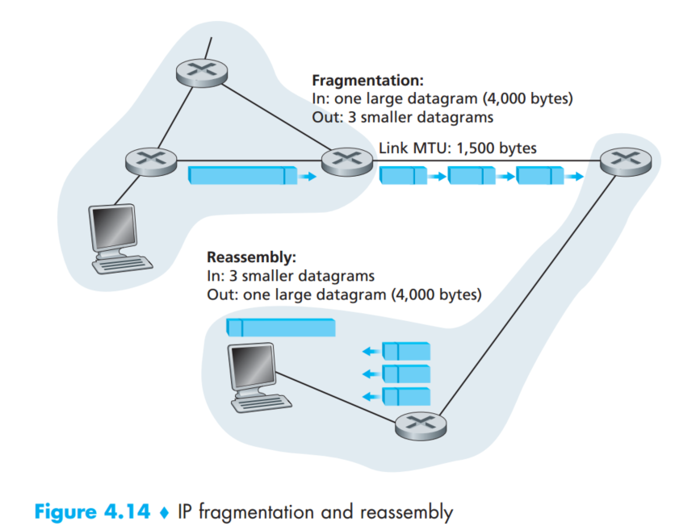
IP Datagram Fragmentation
Maximum Transmission Unit
Maximum amount of data that a link-layer can carry
Different MTU
Fragmentation Occurs
Some fields are used for uniting fragments
Fragmented datagram reassembly in the end system on IPv4

Slide 34
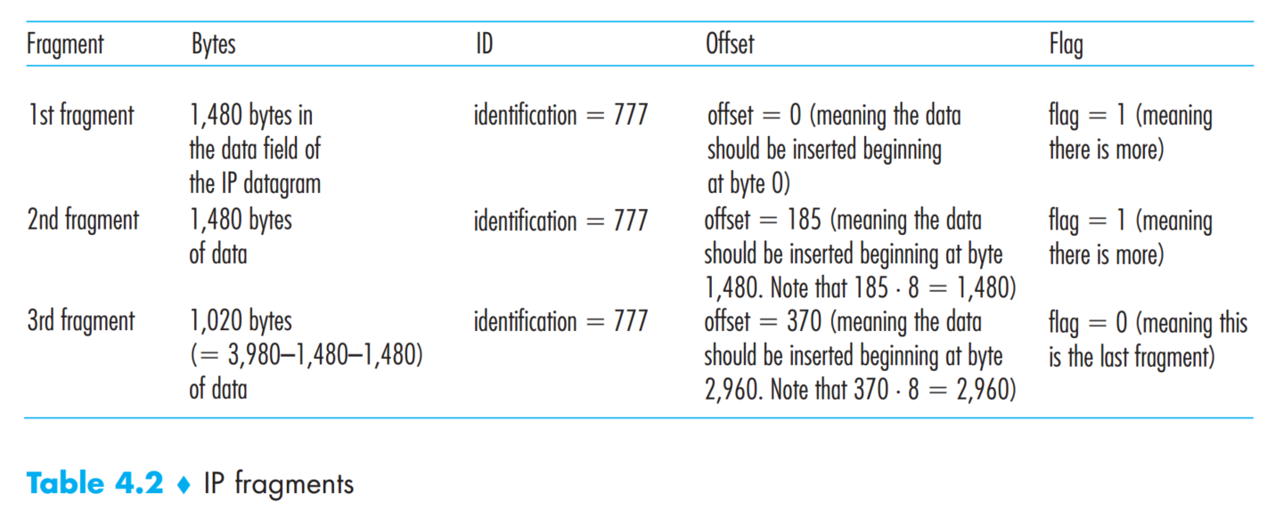
Example of Fragmentation
Bytes indicates size of data
Original datagram is stamped with ID 777
Offset indicates beginning point
Flag indicates whether the fragment is final fragment or not

Slide 35
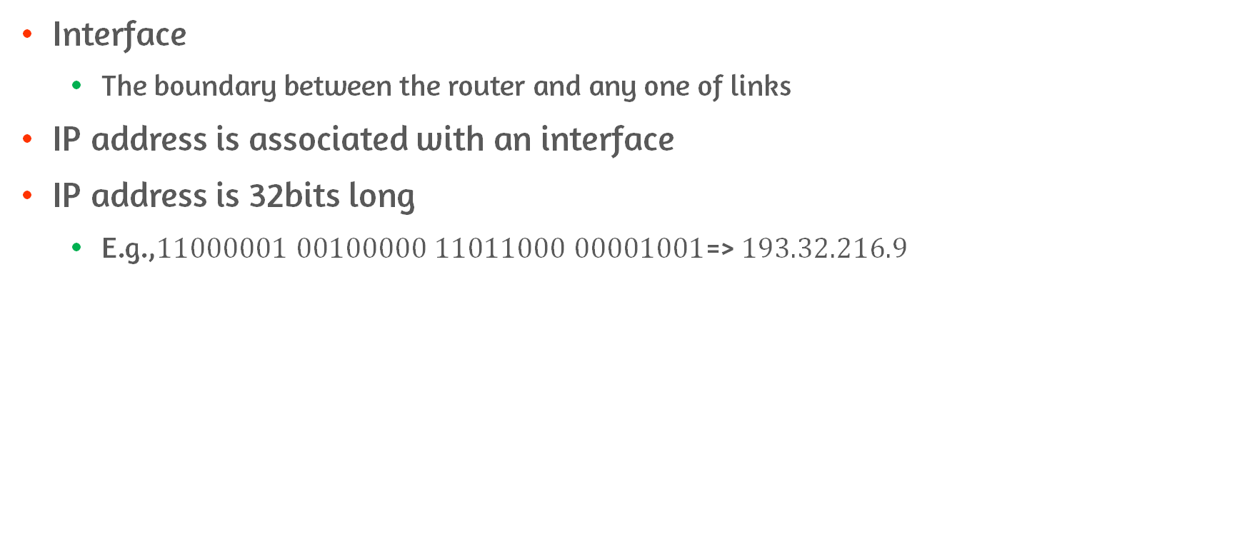
IPv4 Addressing
Interface
The boundary between the router and any one of links
IP address is associated with an interface
IP address is 32bits long
E.g.,$11000001 00100000 11011000 00001001$=> $193.32.216.9$

Slide 36
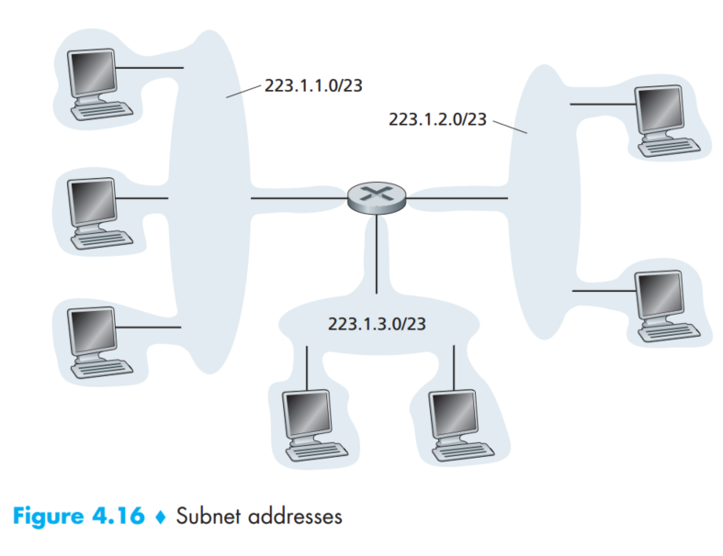
Subnet
Subnet
The network interconnecting interfaces of hosts and router
Subnet mask
IP address assigned to subnet
E.g., all hosts within the 223.1.1.0/23
Share leftmost 24bits of address

Slide 37
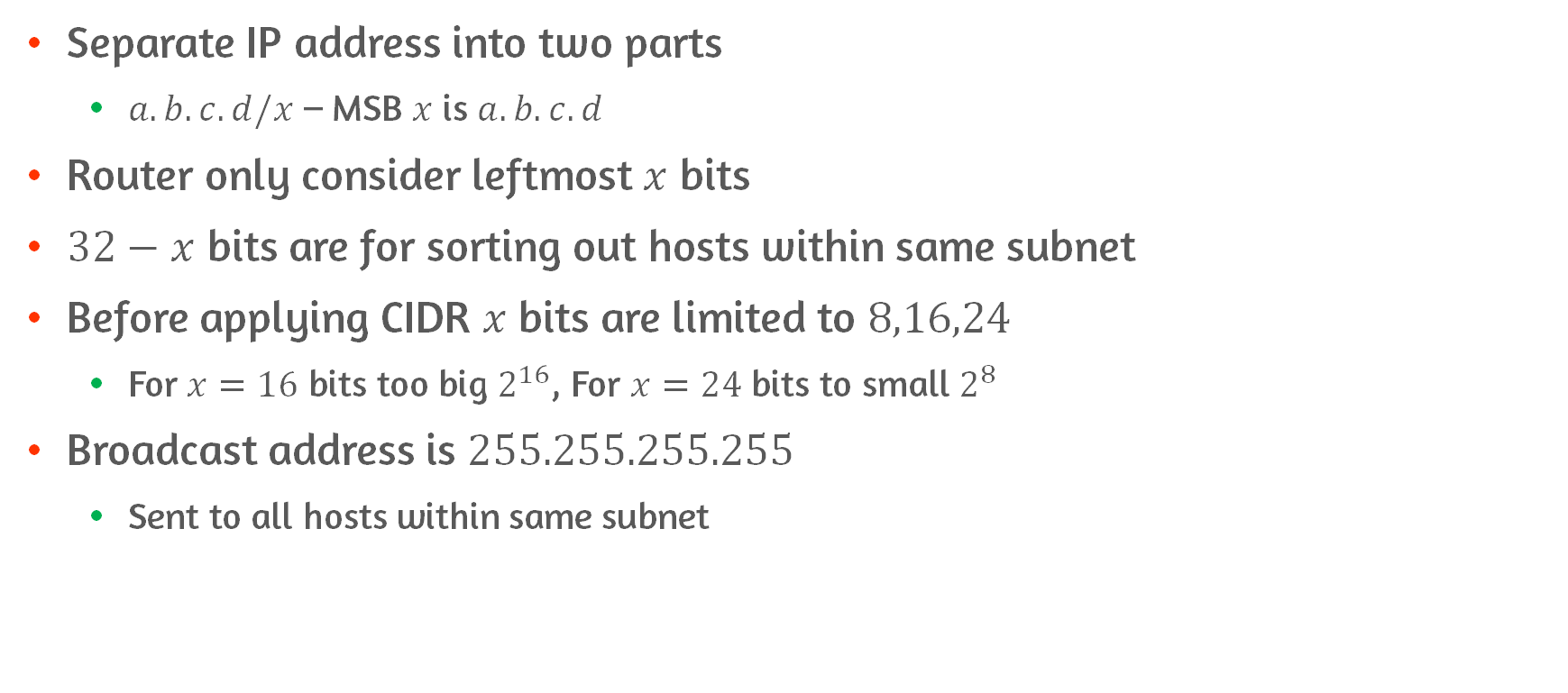
Classless InterDomain Routing
Separate IP address into two parts
$a.b.c.d/x$ – MSB $x$ is $a.b.c.d$
Router only consider leftmost $x$ bits
$32−x$ bits are for sorting out hosts within same subnet
Before applying CIDR $x$ bits are limited to $8,16,24$
For $x=16$ bits too big $2^{16}$, For $x=24$ bits to small $2^{8}$
Broadcast address is $255.255.255.255$
Sent to all hosts within same subnet

Slide 38
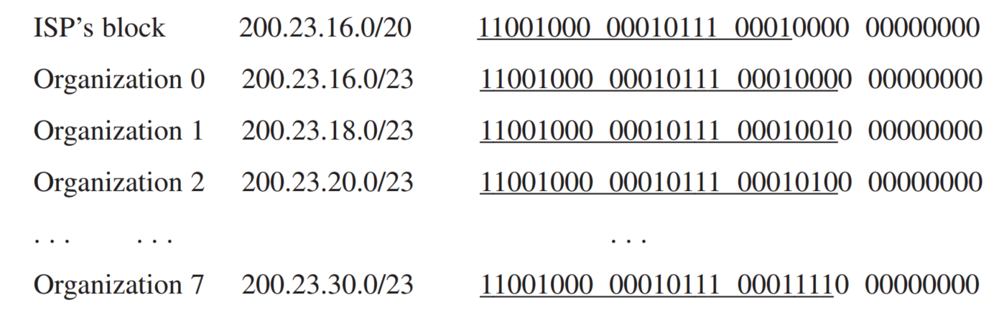
Obtaining a Block of Addresses
Organization can get IP address block from ISP
ISP can get IP address block from ICANN

Slide 39
Dynamic Host Configuration Protocol
Dynamically allocating IP addresses to host
Also, allowing a host additional information(address of local DNS server…)
DHCP server allocates IP address to host within a certain set of addresses
Plug and play protocol
Automate the procedure of connecting host into a network
Client server protocol
Newly arriving host obtain network configuration information including IP address

Slide 40
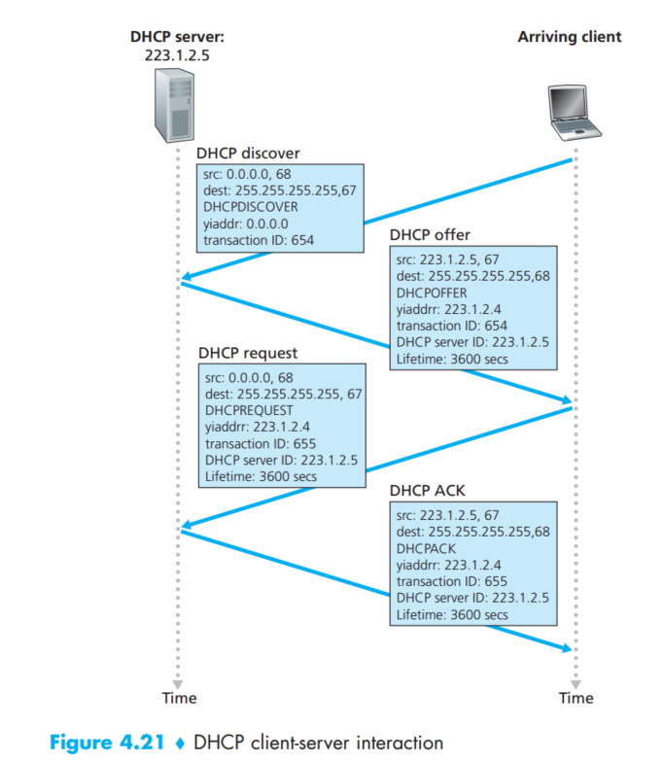
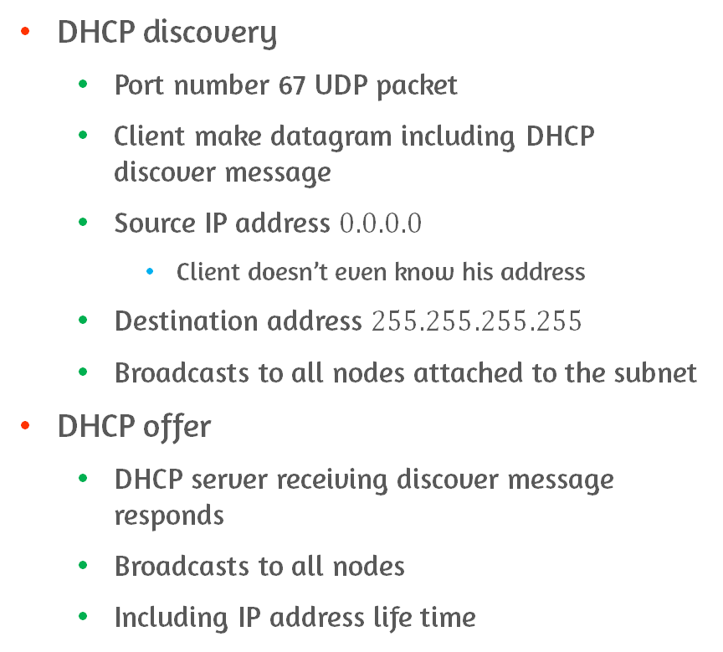
Four Steps of DHCP #1
DHCP discovery
Port number 67 UDP packet
Client make datagram including DHCP discover message
Source IP address $0.0.0.0$
Client doesn’t even know his address
Destination address $255.255.255.255$
Broadcasts to all nodes attached to the subnet
DHCP offer
DHCP server receiving discover message responds
Broadcasts to all nodes
Including IP address life time

Slide 41
Four Steps of DHCP #2
The reason for broadcasting DHCP server offer
Several DHCP server exists on the same subnet
Client chose optimal DHCP server
DHCP request
Chose from one or more server offers
Can exist more than one DHCP server
Respond by echoing back
DHCP ACK
Server responds to the DHCP request message

Slide 42
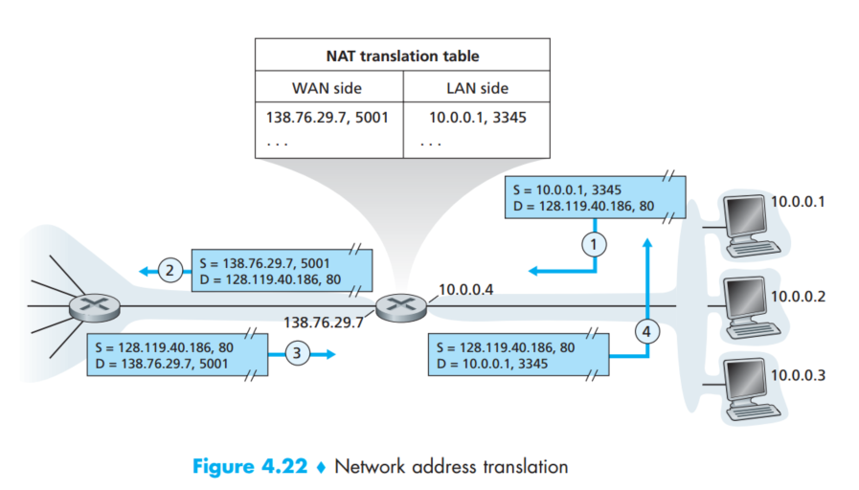
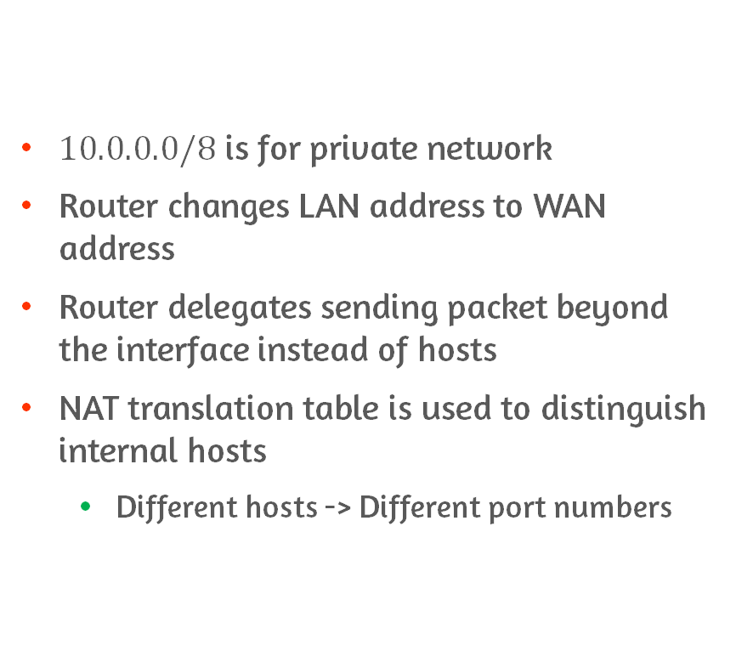
Network Address Translation
$10.0.0.0/8$ is for private network
Router changes LAN address to WAN address
Router delegates sending packet beyond the interface instead of hosts
NAT translation table is used to distinguish internal hosts
Different hosts -> Different port numbers

Slide 43
The Problem of Using NAT
Interferes with P2P applications
Hosts in P2P session must operate as servers
The host behind NAT can not operate as server
The solution
Connection reversal
Set the intermediate to establish P2P session

Slide 44
UPnP
Universal Plug and Play is provided to NAT
A protocol allowing a host to discover and configure nearby NAT
UPnP allows a host to map private IP address and port number to public IP address and port number
Nodes from the outside can initiate connection with public IP address and port number
Allows external hosts to initiate communication sessions to NATed hosts

Slide 45
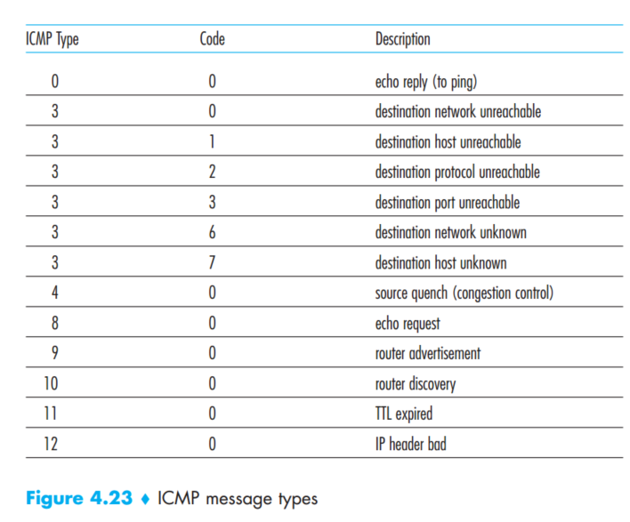
ICMP
Communicate network layer information
Used for error reporting
ICMP messages are carried inside IP datagrams
Multiplexing and demultiplexing
Ping message is ICMP type 8
Source quench message is for congestion control (not used)
TTL decrements by 1 when sent by sender

Slide 46
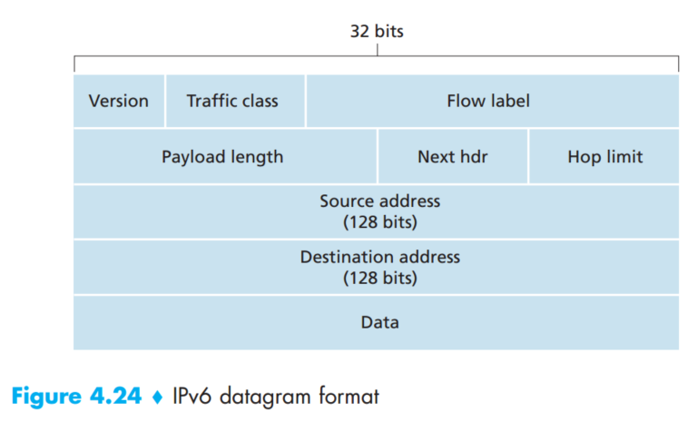
IPv6 Datagram Format
The difference from IPv4
Extended address 32bit -> 128bit
40byte fixed length header
Flow labeling and priority
Traffic class
Similar to TOS in IPv4
Payload length
Length of data
Hop limit
Decreases one by each router
Next hdr
Upper layer protocol

Slide 47
Deleted IPv4 Fields
Fragmentation/Reassembly
IPv6 only allow fragmentation/reassembly on end systems
Header checksum
Does not need check-summing since transport layer and link layer did it
Options
Options field is extracted to next header pointed from next hdr field
Fixed 40 bytes header possible

Slide 48
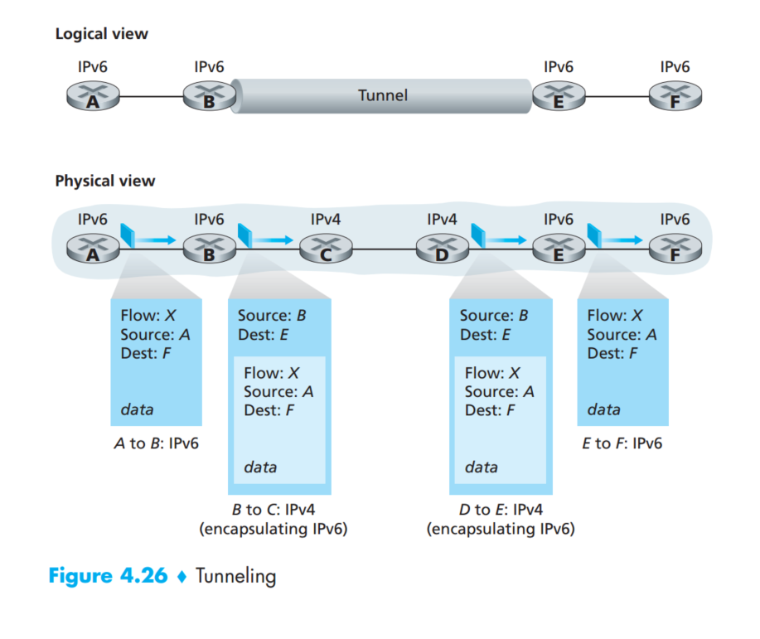
Transitioning from IPv4 to IPv6
Flag day
Turning off all internet devices and upgrade
Dual-stack approach
IPv6/IPv4 node can handle both protocols
Some fields are dropped if router along the path only handle IPv4 (IPv6 datagram is sent)
Tunneling
IPv6 datagram is treated as data for IPv4 node

Slide 49
IPsec’s Transport Mode
Transport layer sends segment to IPsec layer
IPsec encrypts segment append security fields
Encapsulate resulting payload into IP datagram
Services provided by IPsec
Cryptographic agreement
Encryption of IP datagram payloads
Data integrity
Origin authentication

Slide 50
4.5 Routing Algorithms

Slide 51
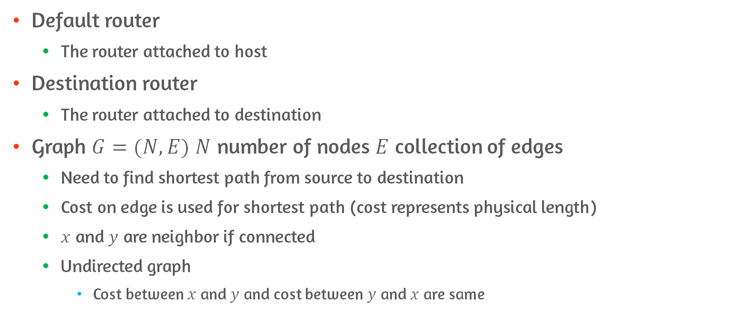
Introduction of Routing Algorithms
Default router
The router attached to host
Destination router
The router attached to destination
Graph $G=(N,E)$ $N$ number of nodes $E$ collection of edges
Need to find shortest path from source to destination
Cost on edge is used for shortest path (cost represents physical length)
$x$ and $y$ are neighbor if connected
Undirected graph
Cost between $x$ and $y$ and cost between $y$ and $x$ are same

Slide 52
Classification of Routing Algorithms
A global routing algorithm
Computes least cost path using complete knowledge about network
Link-state algorithm
A decentralized routing algorithm
Calculate least cost path with iteration using non-complete knowledge about network
Distance-vector algorithm
Static/Dynamic routing algorithms
The speed of path change
Load-sensitive/insensitive algorithms
Highly depend on link-cost or not

Slide 53
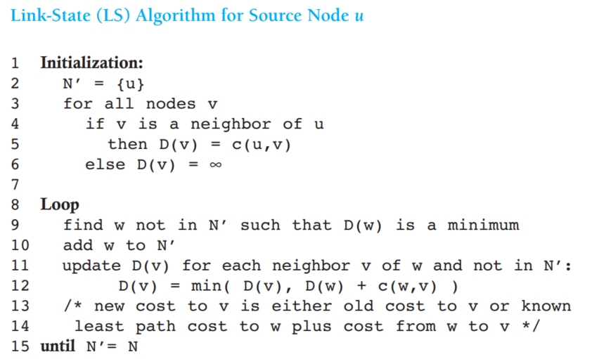
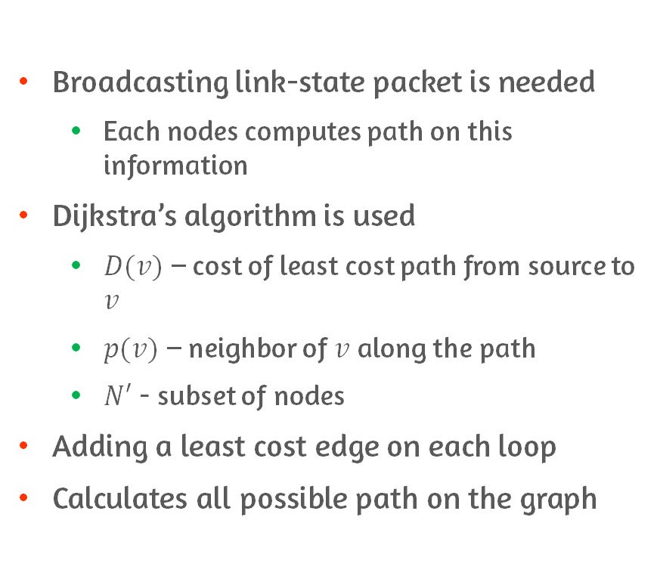
The Link-State Routing Algorithm
Broadcasting link-state packet is needed
Each nodes computes path on this information
Dijkstra’s algorithm is used
$D(v)$ – cost of least cost path from source to $v$
$p(v)$ – neighbor of $v$ along the path
$N′$ - subset of nodes
Adding a least cost edge on each loop
Calculates all possible path on the graph

Slide 54
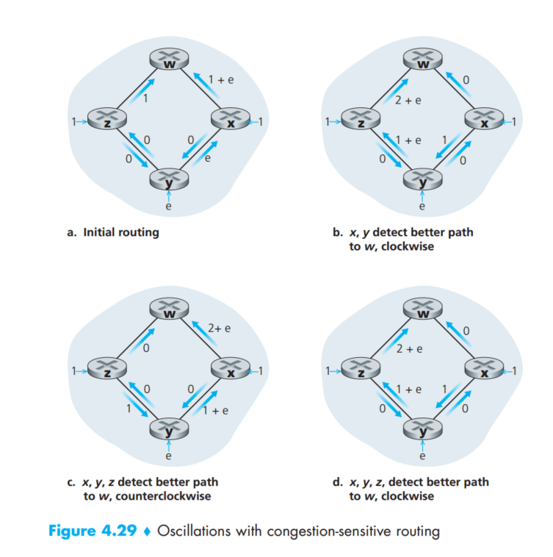
Oscillations
First applying LS algorithm determines clock wise sending is least cost
Adding load into link
After load is added LS algorithm determines counter clock wise is least cost
To prevent oscillations
Randomize the time algorithm applies

Slide 55
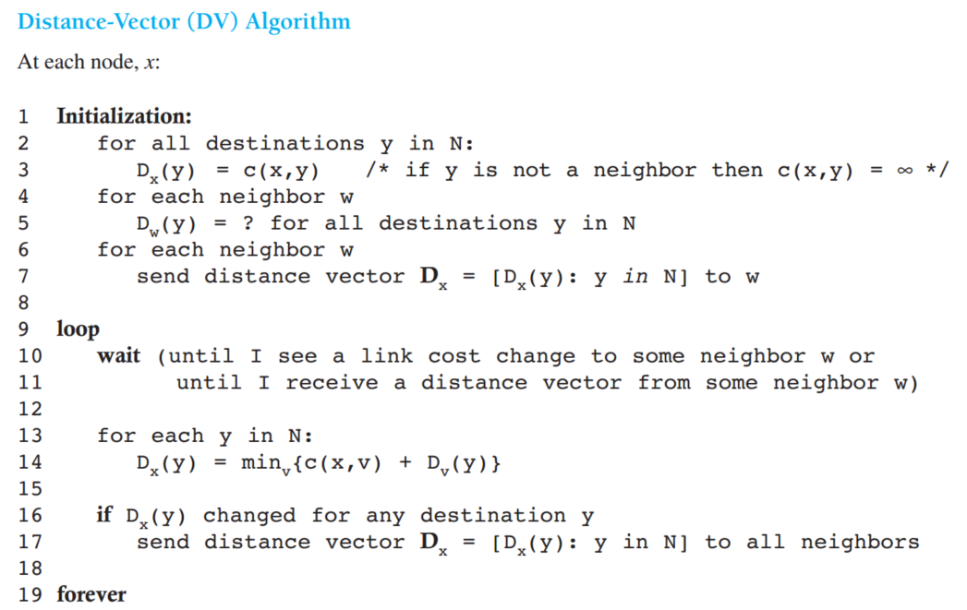
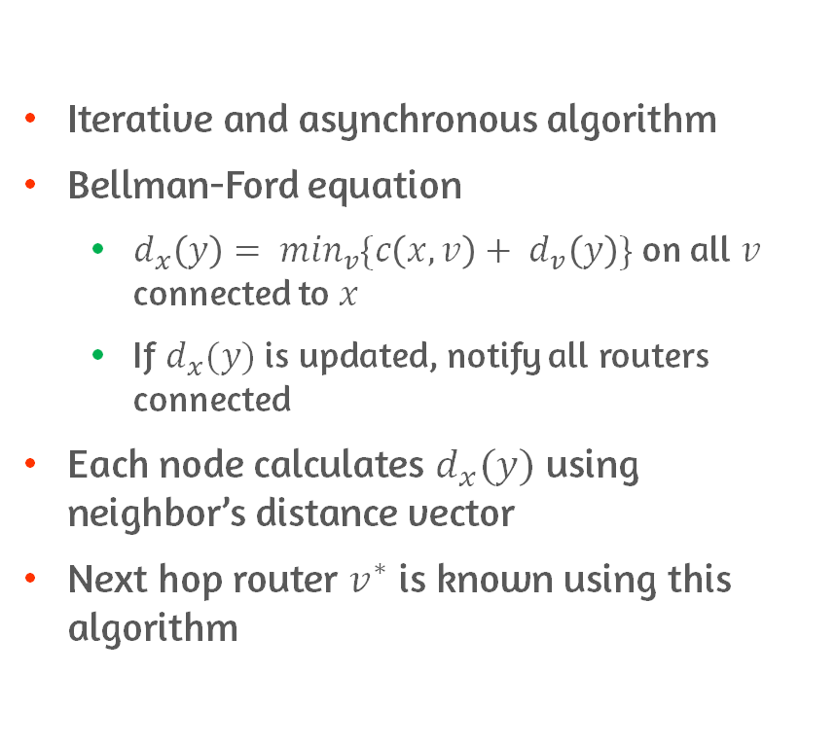
The Distance Vector Routing Algorithm
Iterative and asynchronous algorithm
Bellman-Ford equation
$d_{x}\left(y\right)= \min_{v}\{c\left(x,v\right)+ d_{v}\left(y\right)\}$ on all $v$ connected to $x$
If $d_{x}(y)$ is updated, notify all routers connected
Each node calculates $d_{x}(y)$ using neighbor’s distance vector
Next hop router $v^{∗}$ is known using this algorithm

Slide 56
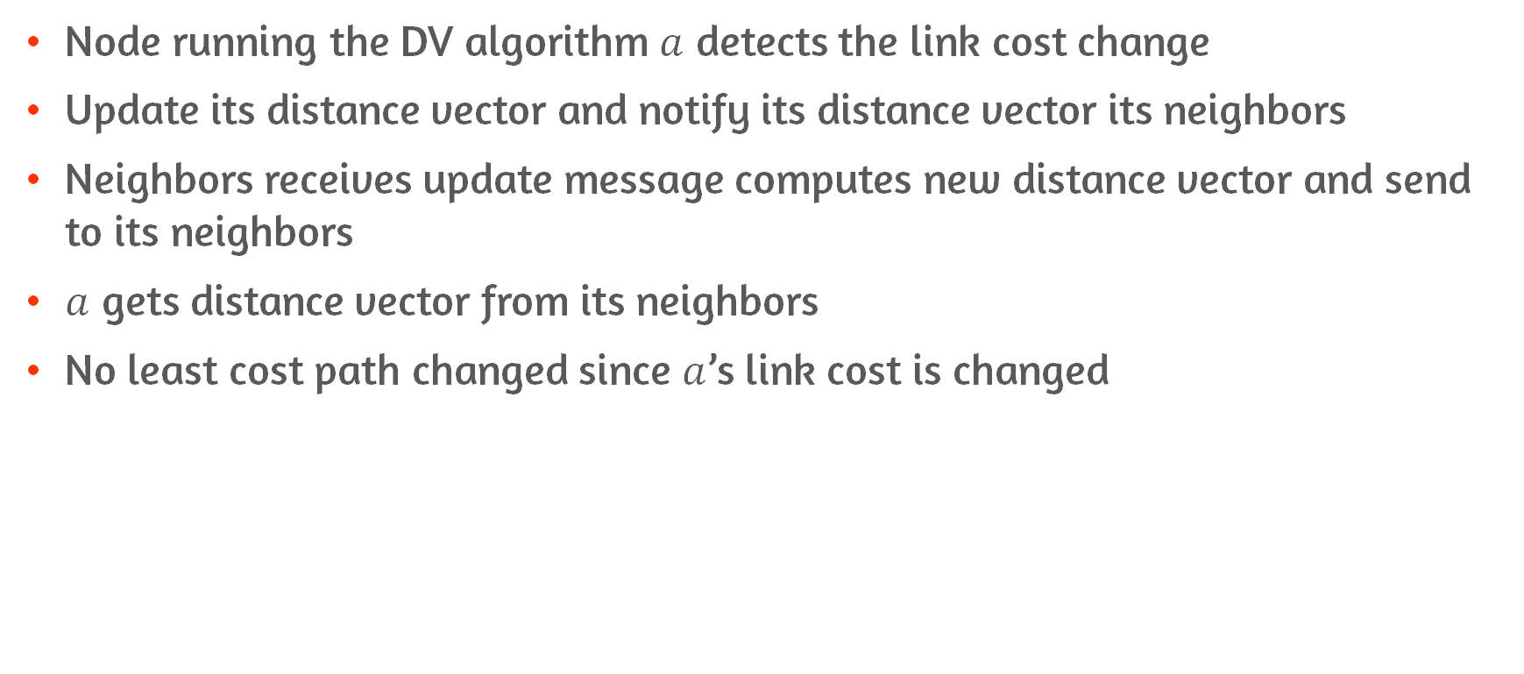
DV Algorithm : Link-Cost Changes
Node running the DV algorithm $a$ detects the link cost change
Update its distance vector and notify its distance vector its neighbors
Neighbors receives update message computes new distance vector and send to its neighbors
$a$ gets distance vector from its neighbors
No least cost path changed since $a$’s link cost is changed

Slide 57
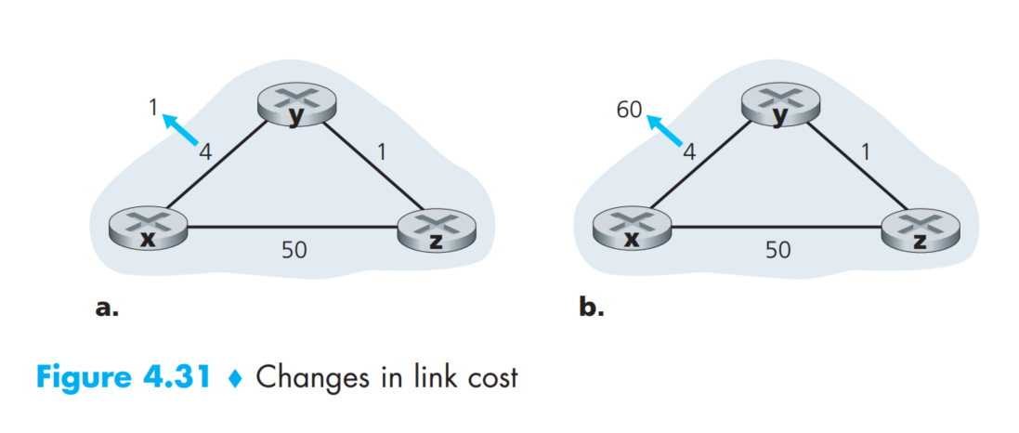
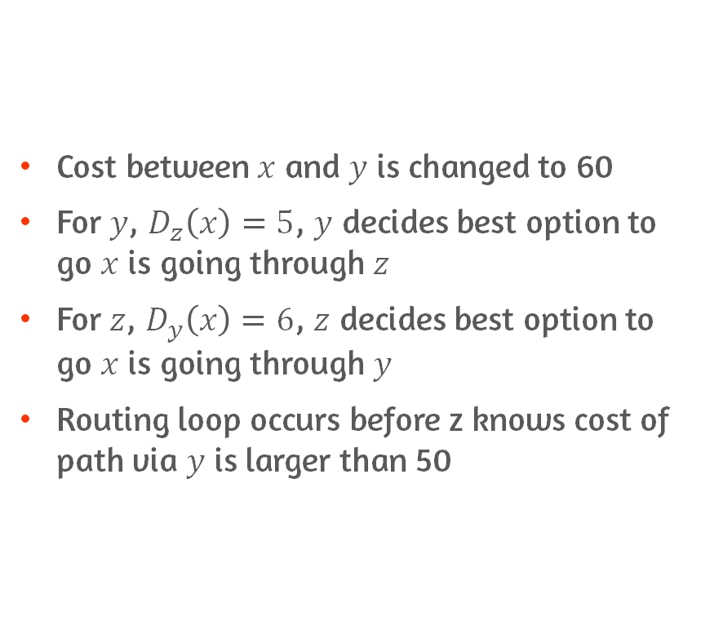
DV Algorithm : Link Failure
Cost between $x$ and $y$ is changed to 60
For $y$, $D_{z}\left(x\right)=5$, $y$ decides best option to go $x$ is going through $z$
For $z$, $D_{y}\left(x\right)=6$, $z$ decides best option to go $x$ is going through $y$
Routing loop occurs before z knows cost of path via $y$ is larger than 50

Slide 58
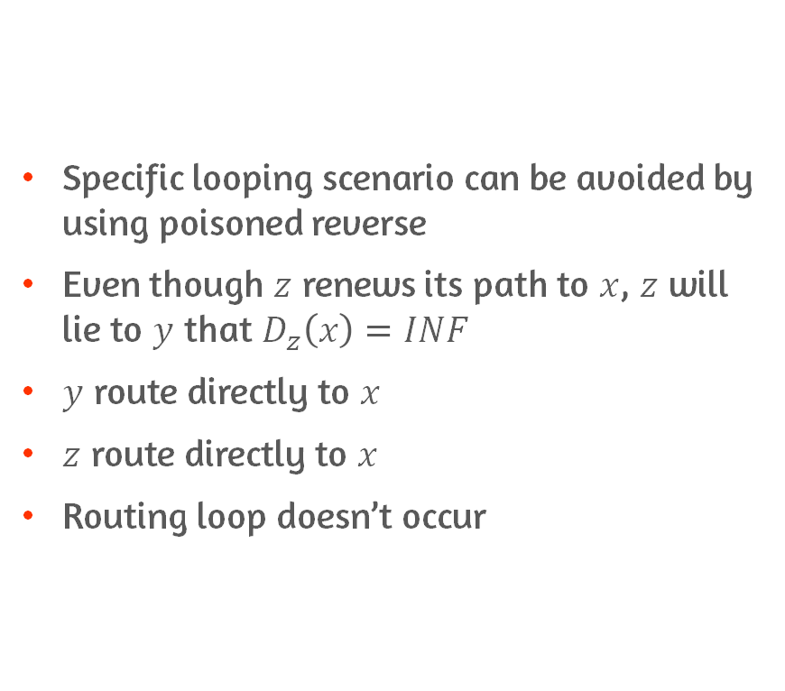
DV Algorithm : Adding Poisoned Reverse
Specific looping scenario can be avoided by using poisoned reverse
Even though $z$ renews its path to $x$, $z$ will lie to $y$ that $D_{z}\left(x\right)=INF$
$y$ route directly to $x$
$z$ route directly to $x$
Routing loop doesn’t occur

Slide 59
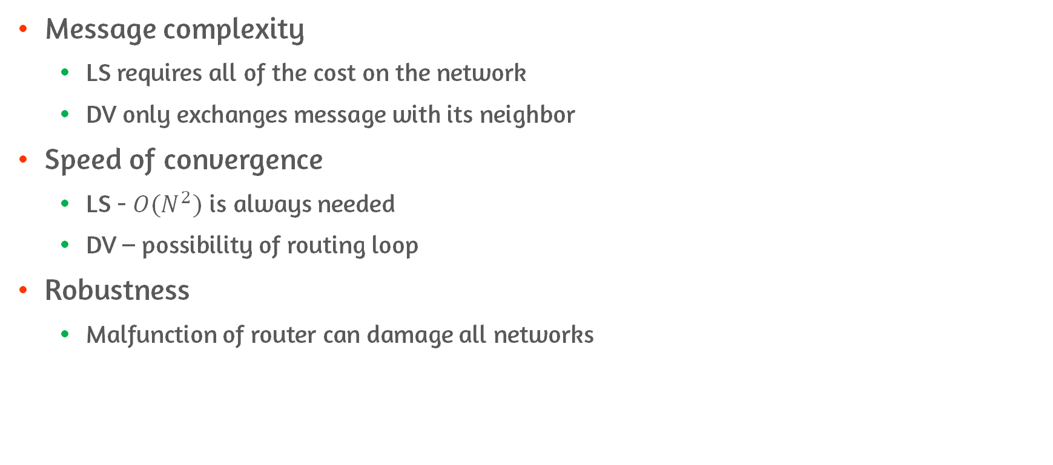
Comparison of LS and DV
Message complexity
LS requires all of the cost on the network
DV only exchanges message with its neighbor
Speed of convergence
LS - $O(N^{2})$ is always needed
DV – possibility of routing loop
Robustness
Malfunction of router can damage all networks

Slide 60
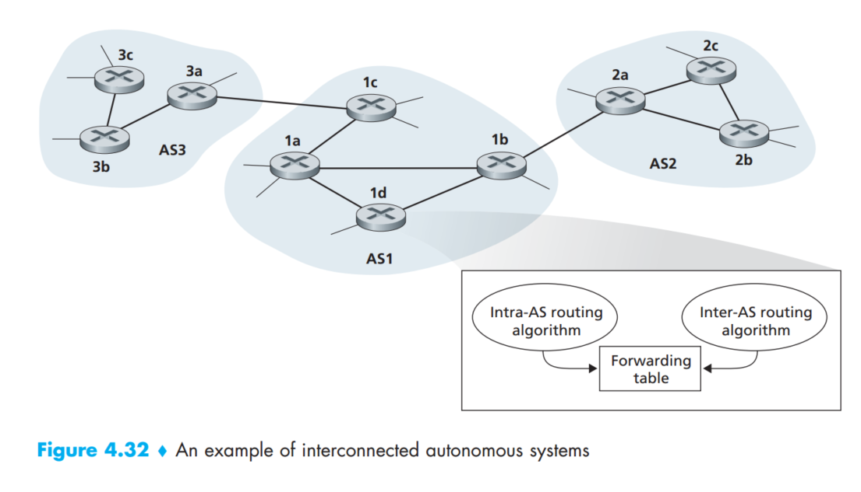
Hierarchical Routing
Autonomous System of routers
Scale
The overhead is too large for handling all nodes in network
Administrative autonomy
Able to run by local policy
Intra AS routing protocol
Routing algorithm running within AS
Gateway router
Router forwarding to outside of AS
Inter AS routing protocol
AS communicating each other

Slide 61
4.6 Routing in The Internet

Slide 62
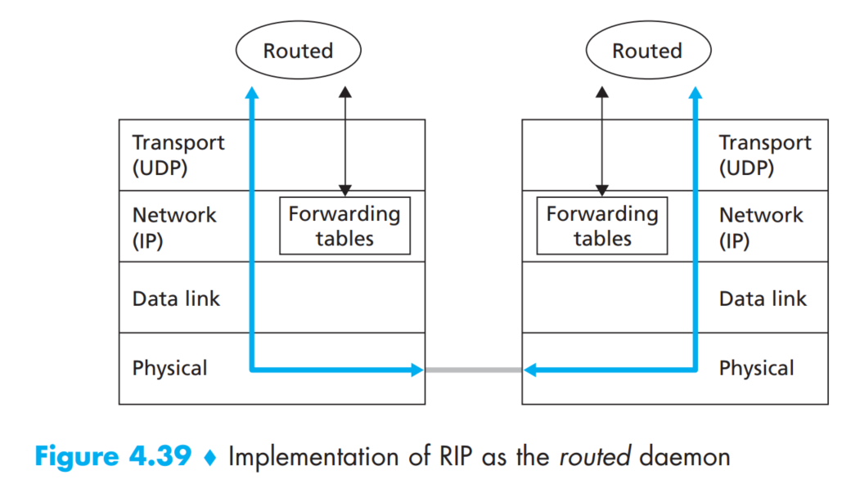
Intra-AS Routing : RIP
Routing Information Protocol
Based on DV algorithm
Cost is hop count - each link has 1 cost
RIP response message
Advertising its routing table to nodes nearby
Each router has routing table
Including distance vector and forwarding table
RIP is application protocol above UDP

Slide 63
Intra-AS Routing : OSPF
Open Shortest Path First
Based on LS
Router broadcasts routing information
Security
Only authenticated routing information is acknowledged
Sequence numbers used for preventing replay attack
Support for multicast and unicast routing
Support for hierarchy
Can be configured into areas
Backbone area route traffic between the other areas
Backbone area interconnect between the areas

Slide 64
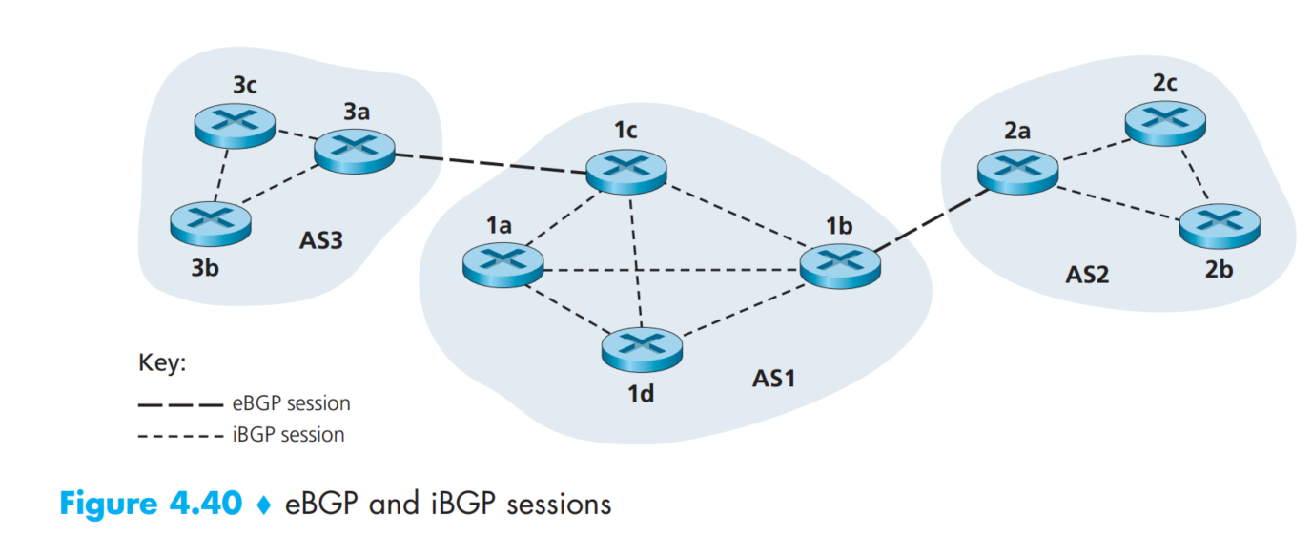
Inter-AS Routing : BGP
BGP provides services to AS
Obtain reachability information from neighbor ASs
Propagate reachability information to all neighbor ASs
Determine path
BGP basics
eBGP session
TCP session between ASs
iBGP session
TCP session in the same AS
BGP peers
Two routers at the end of connection

Slide 65
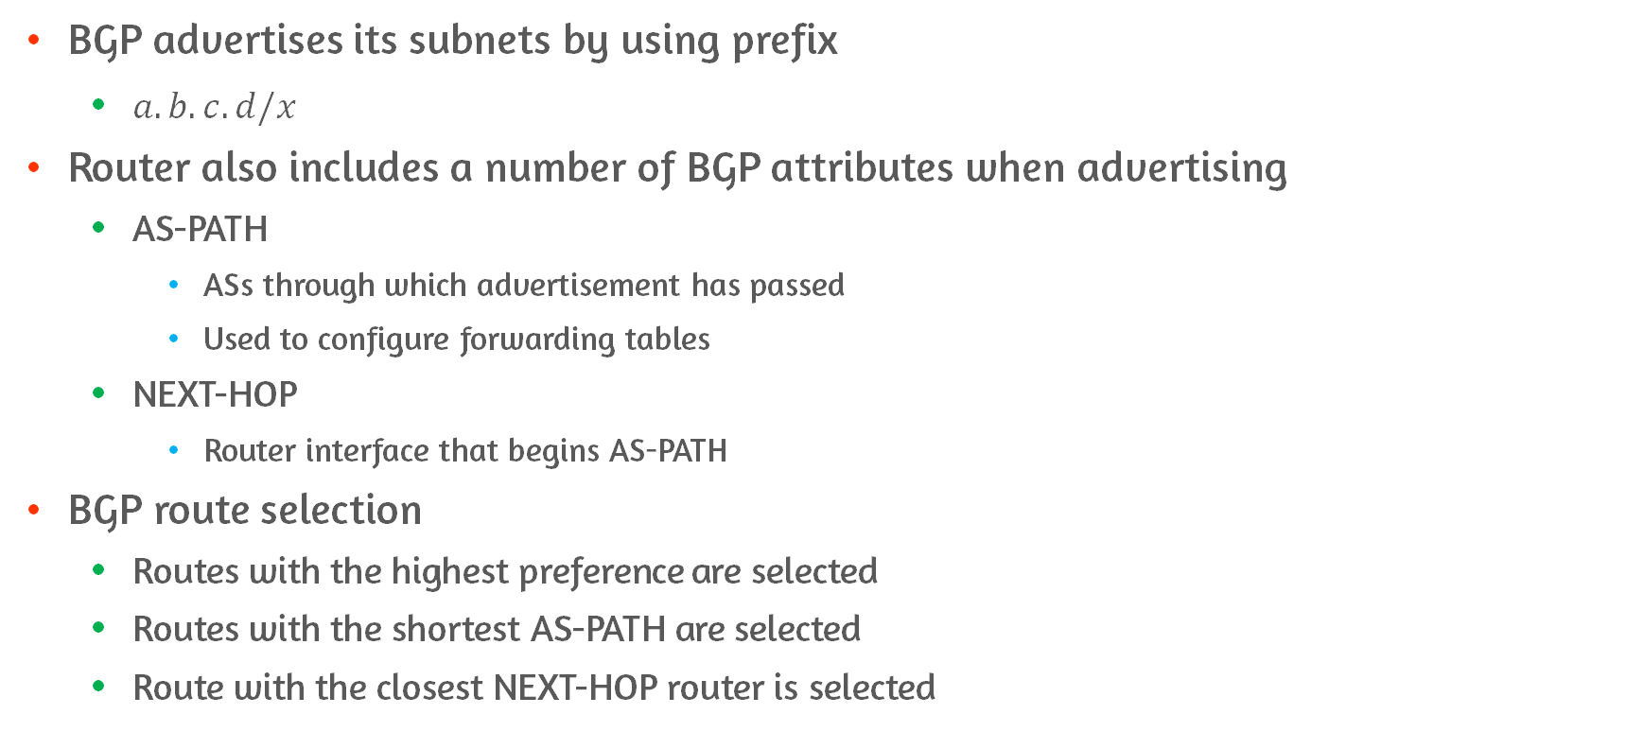
Path Attributes and BGP Routes
BGP advertises its subnets by using prefix
$a.b.c.d/x$
Router also includes a number of BGP attributes when advertising
AS-PATH
ASs through which advertisement has passed
Used to configure forwarding tables
NEXT-HOP
Router interface that begins AS-PATH
BGP route selection
Routes with the highest preference are selected
Routes with the shortest AS-PATH are selected
Route with the closest NEXT-HOP router is selected

Slide 66
4.7 Broadcast and Multicast Routing

Slide 67
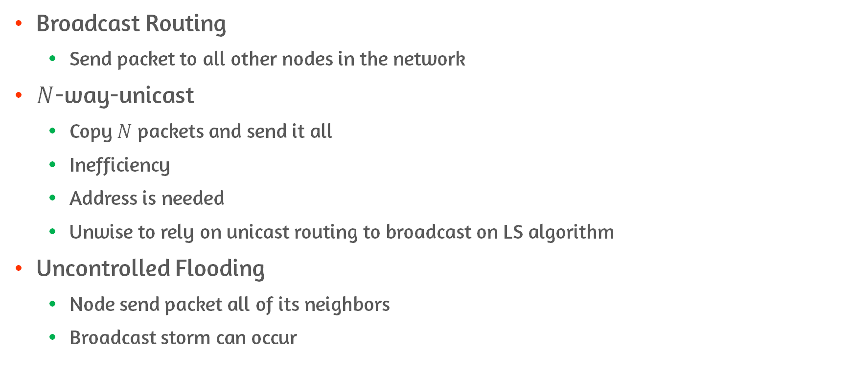
Broadcast Routing Algorithm
Broadcast Routing
Send packet to all other nodes in the network
$N$-way-unicast
Copy $N$ packets and send it all
Inefficiency
Address is needed
Unwise to rely on unicast routing to broadcast on LS algorithm
Uncontrolled Flooding
Node send packet all of its neighbors
Broadcast storm can occur

Slide 68
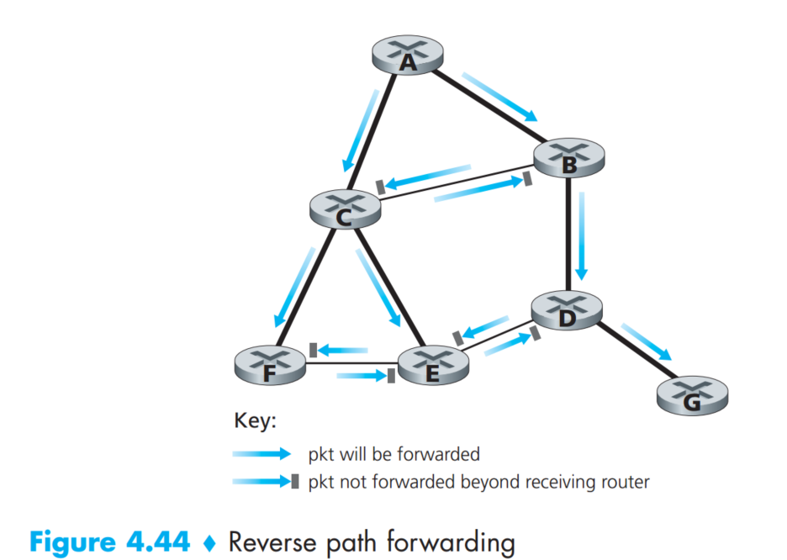
Broadcast Routing Algorithm : Controlled Flooding
Sequence number controlled flooding
Save already received broadcast packet with a sequence number
Reverse path forwarding
Only receive the packet if the path that packet is sent is shortest path from the source
If above condition is fulfilled, broadcast
E.g., B ignore packet from C since packet through C is not the shortest path from A

Slide 69
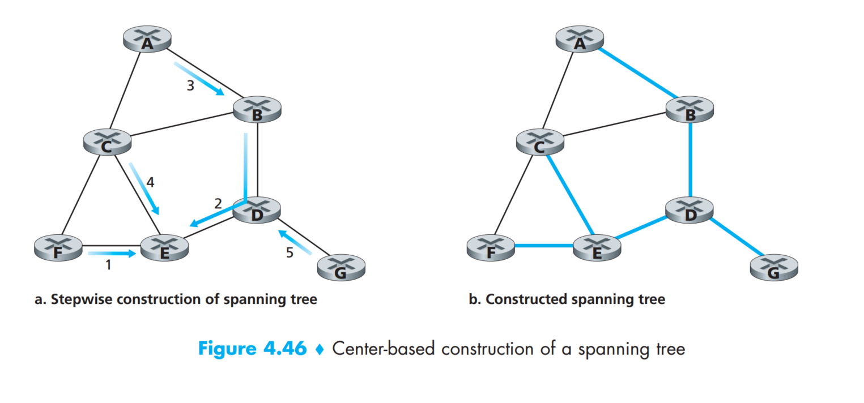
Broadcast Routing Algorithm : Spanning Tree Broadcast
Spanning tree
A tree that contains every node in graph
No cycle
Source node send the broadcast packet along the spanning tree
Center-based approach
E.g., E is center node
Spanning tree is constructed starting from E

Slide 70
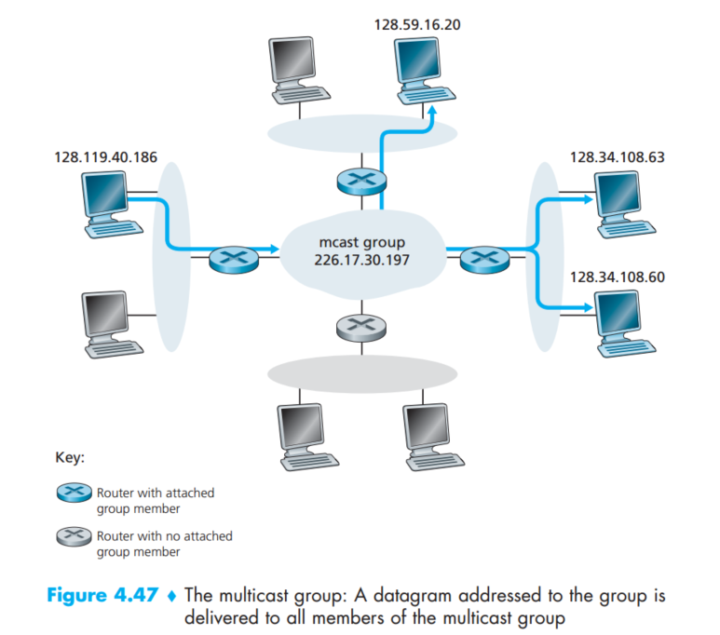
Multicast
Sending packet to certain group
E.g., Streaming
Use address indirection
Different Host with Different address is associated with multicast group
IGMP is used for taking care of group
Internet Group Management Protocol

Slide 71
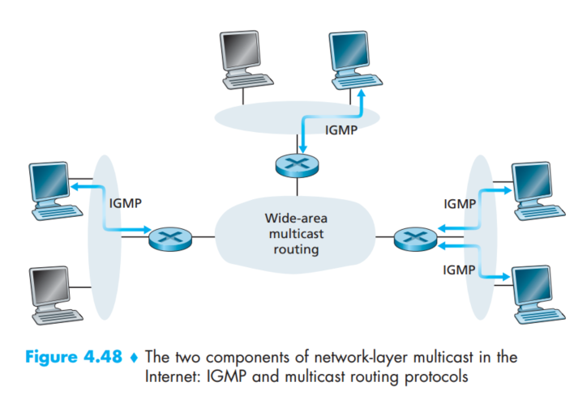
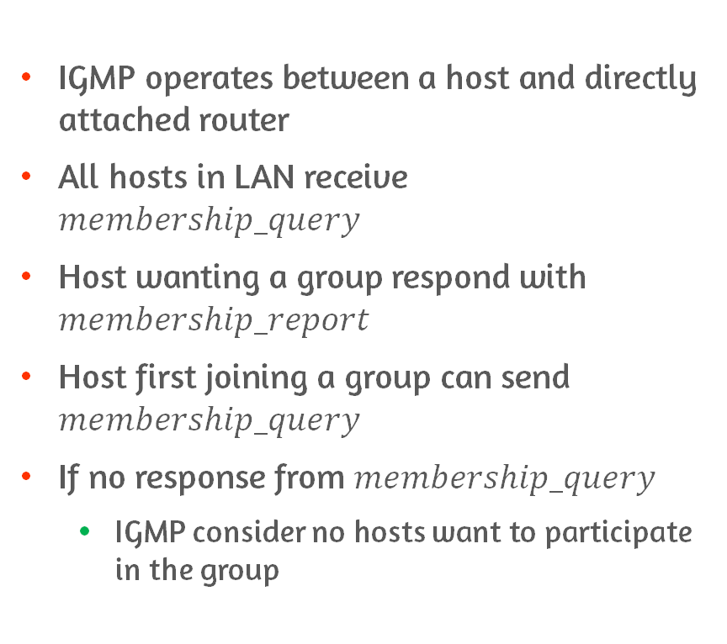
IGMP
IGMP operates between a host and directly attached router
All hosts in LAN receive $membership_query$
Host wanting a group respond with $membership_report$
Host first joining a group can send $membership_query$
If no response from $membership_query$
IGMP consider no hosts want to participate in the group

Slide 72

Multicast Routing Algorithm
Group shared tree multicast
Router within group make spanning tree
Can include the router not associated with multicast
Source based tree multicast
Use ReversePathForwarding algorithm to establish tree
Pruning
Delete non-multicast node from tree

Slide 73
Conclusion
Change virtual circuit to datagram to make router’s job easier
Learn how router really works by examining inside of router
IPv4 and IPv6
Routing algorithm is needed to determine the best path
Learn how broadcasting and multicasting works

